Slide 1
Airline Sentiment Analysis
MGSC 410-01
Yuna Kim
Assignment 1

Slide 2
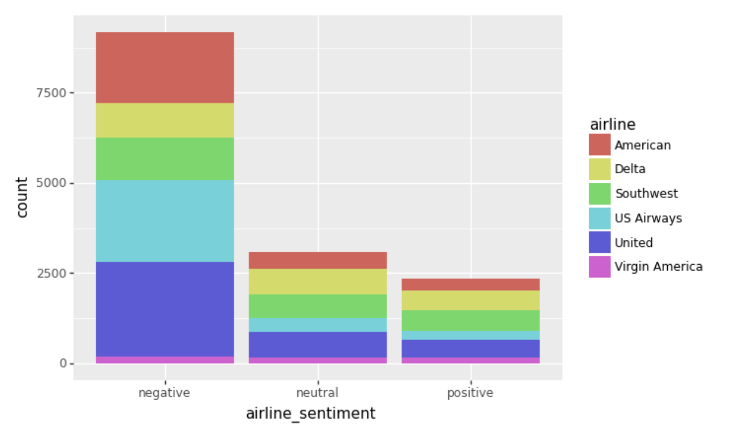
Exploratory Analysis
Negative sentiment is predominant. Positive sentiment is even lower than neutral sentiment.
Among the negative sentiment tweets, most of them are referring to American Airline, US Airways Airline, and United Airline.
Among the neutral and positive tweets, Southwest is predominant.

Slide 3
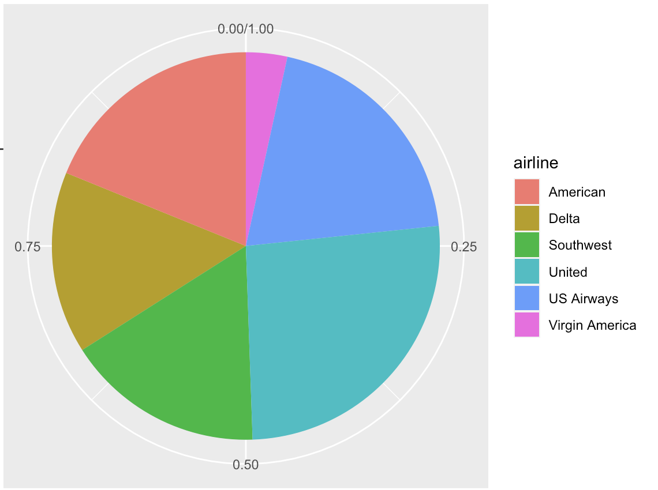
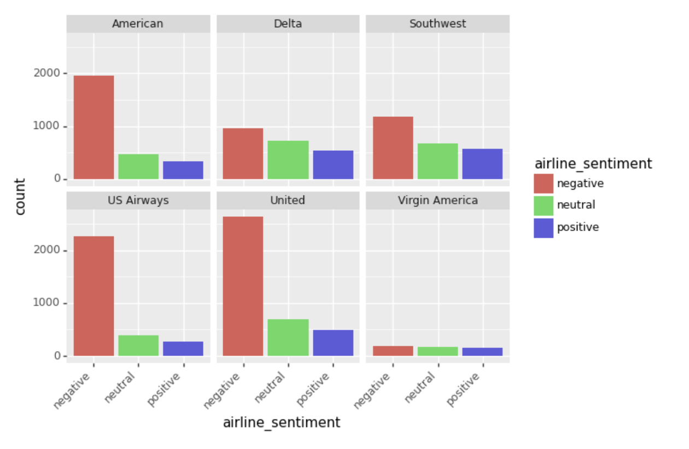
Exploratory Analysis
It could be that United has high negative tweets because they have large number of tweets, but the graph on the right shows that they have comparatively more negative tweets to other tweets than different airlines.
United Airline and US Airways Airline were the most tweeted; Virgin America Airline was the least tweeted.
Delta and Virgin America have the least negative tweets compared to the neutrals and the positives; United and US Airways have the most count of negative tweets than the neutrals and the positives.

Slide 4
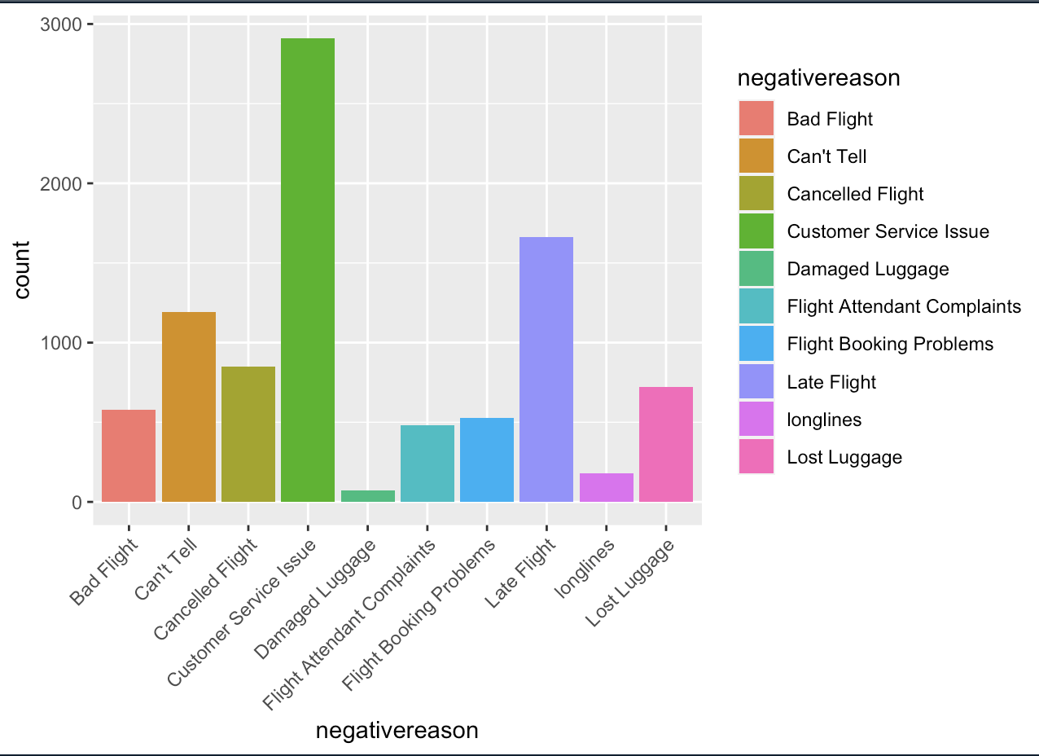
Exploratory Analysis
The most frequent reason of negative tweet is customer service issue, followed by late fight, and the least frequent reason of negative tweet is damaged luggage.

Slide 5
Exploratory Analysis Summary
The most common tweet are negative about the airline experience.
Most number of tweets are about United Airline which is also having the most number of negative tweets.
The number one reason for the negative tweets is bad customer service.

Slide 6
Machine Learning Analysis Plan
Objective:
Predict the airline sentiment classification given these variables: date, time, airline, polarity, and subjectivity. *
Find out which 3 variables are most important at predicting the airline sentiment (feature importance)
Method:
Use sentiment analysis python library, ‘TextBlob’, to create the features ‘polarity’ and ‘subjectivity’.
Implement different classification models and choose the best performing model by comparing accuracy scores.
*Description about changes made to the data columns are described in appendix.

Slide 7
Models without hyperparameter & tuning
Logistic Regression
Accuracy score for train set: 0.621
Accuracy score for test set: 0.638
Decision Tree
Accuracy score for train set: 0.999
Accuracy score for test set: 0.577
Random Forest
Accuracy score for train set: 0.999
Accuracy score for test set: 0.632
Either underfitting (logistic regression) or too overfitting (decision tree, random forest)!

Slide 8
Models with hyperparameter & tuning
Used GridSearchCV to choose the best parameter.
Logistic Regression
Chosen parameter: {‘C’ : 0.0001, ‘penalty’ : ‘l2’}
Accuracy score for train set: 0.621
Accuracy score for test set: 0.638
Decision Tree
Chosen parameter: {‘max_depth’ : 8, ‘min_samples_leaf’ : 16}
Accuracy score for train set: 0.691
Accuracy score for test set: 0.667
Random Forest
Chosen parameter: {‘max_depth’: 64, ‘min_samples_leaf’ : 8}
Accuracy score for train set: 0.720
Accuracy score for test set: 0.674
Logistic regression showed no change.
No more overfitting for decision tree and random forest!

Slide 9
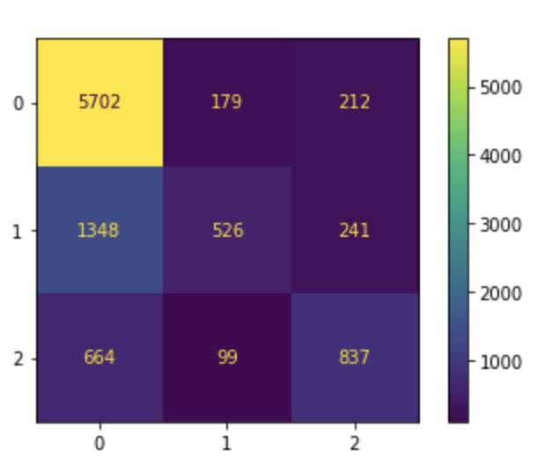
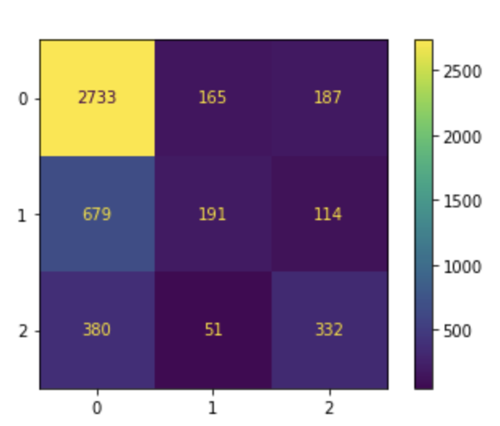
Model performance analysis
Selected Random Forest model because it had the highest accuracy score.
Analyzed Random Forest model using confusion matrix.
Confusion matrix for train set
Confusion matrix for test set
There are many falsely predicted negative tweets and some falsely predicted neutral and positive tweets, but among the predicted value, the correct predictions are the highest.

Slide 10
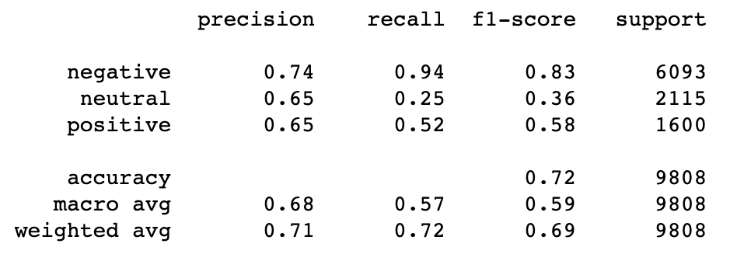
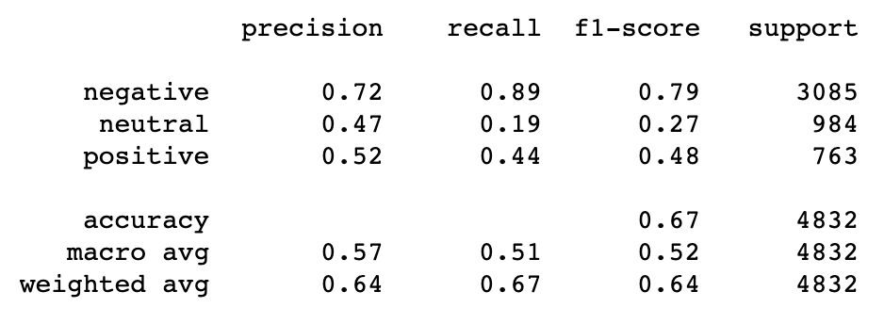
Model performance analysis
<Train Set>
Precision score, recall score, and f1 score shows that
negative tweets are predicted the best, and neutral
tweets are the hardest to predict.
This difference in scores could be a result from different
data size of negative, neutral, and positive tweets.
Negative tweets had the most number of occurrences,
so the model could perform well on predicting negatives.
<Test Set>

Slide 11
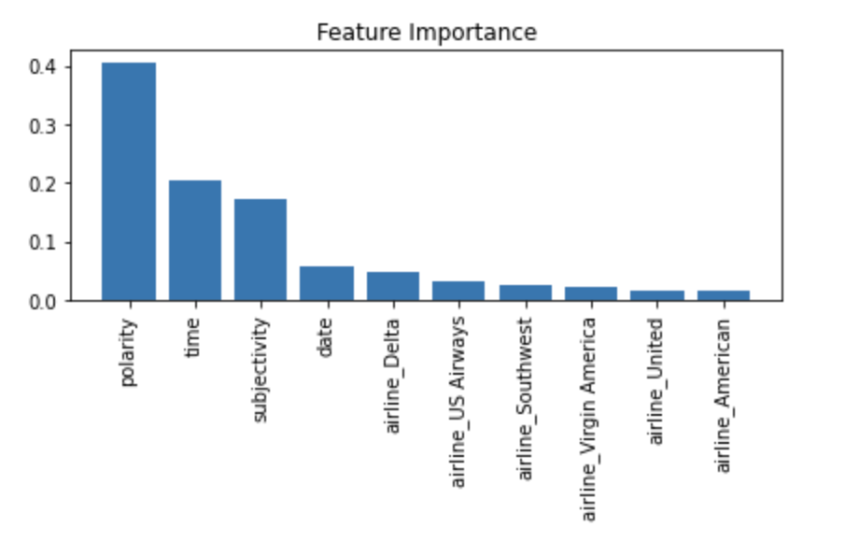
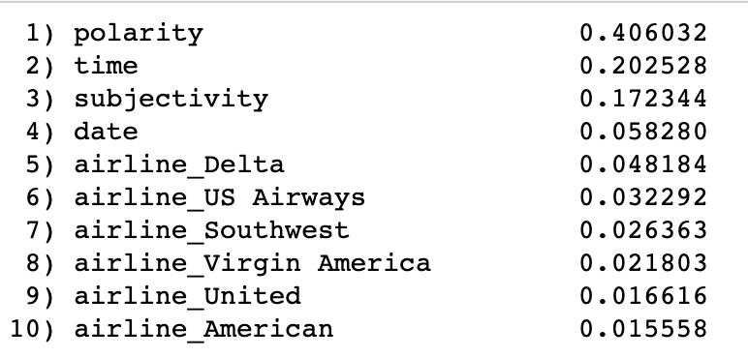
Feature Importance
The top 3 features that are important in predicting the tweets sentiment are polarity, time, and subjectivity.

Slide 12
Executive Summary
Exploratory Analysis:
The most common tweet are negative about the airline experience.
Most number of tweets are about United Airline which is also having the most number of negative tweets.
The number one reason for the negative tweets is bad customer service.
Machine Learning Analysis:
When hyperparameter tuning is not used, all three classification models performed bad.
Best model after hyperparameter tuning is Random Forest.
Negative tweets are predicted better than neutral or positive tweets.
The 3 most important features at predicting the airline tweet sentiment are polarity, time, and subjectivity.

